Slide 1


Session #7:
Arrays.
Functions.

Slide 2
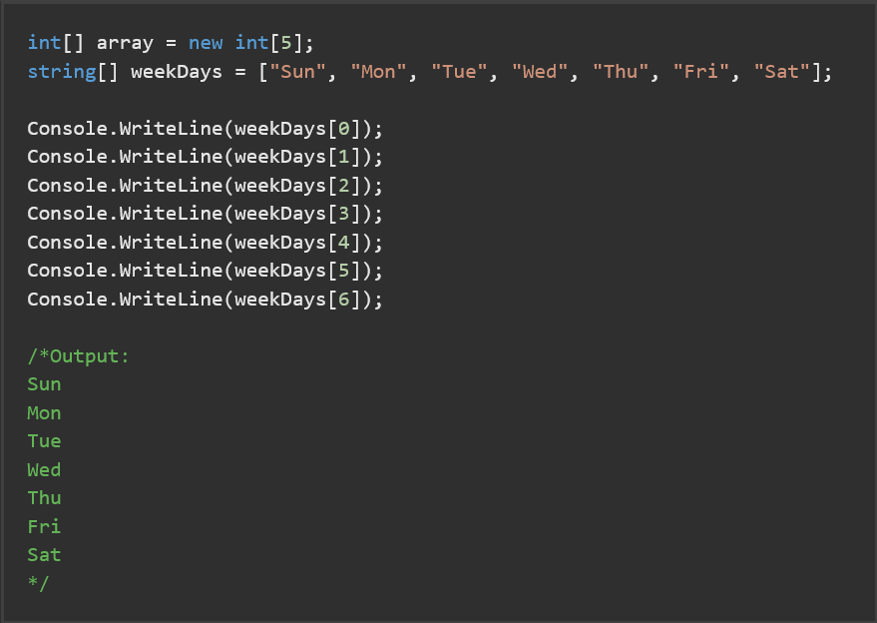
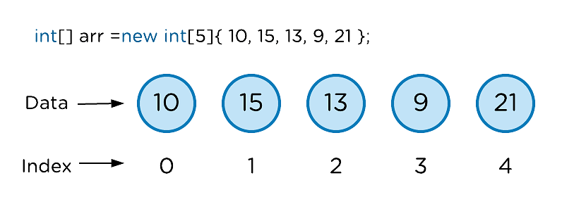
C# Arrays.
Arrays always start at index 0
Arrays.Length() returns number of elements.

Slide 3
C# Arrays.
array.Max() returns largest member of the array.
array.Min() returns smallest member of the array.
array.Sum() returns sum of all members of the array.
array.Average() returns average value of the array members.
Array.Sort( array) will sort array items.
Array.Reverse( array) will reverse items in the array.

Slide 4
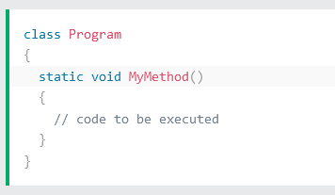
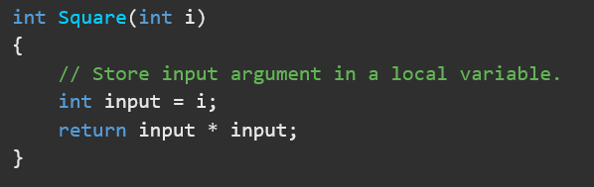
C# Method/function.

